Slide 1
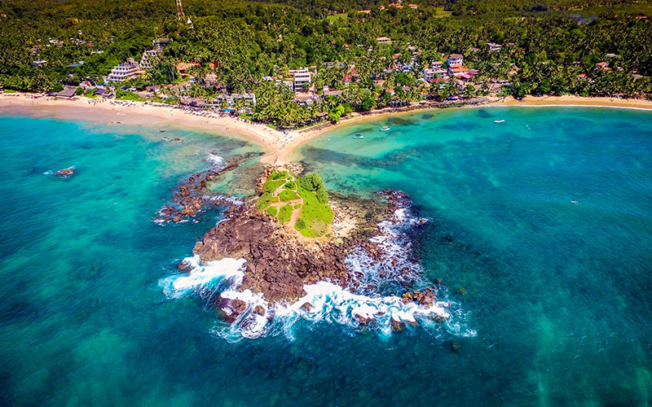
SRI LANKA
02.2.25
Tourism Growth and Travel Preferences: Insights in 2023

Slide 2

CONTENTS
01
02
03
INTRODUCTION
DATASET OVERVIEW
DATA PREPROCESSING
04
PYTHON FOR TOURISM DATA ANALYSIS
05
06
DASHBOARD OVERVIEW
KEY FINDINGS & INSIGHTS
07
FUTURE PREDICTIONS & RECOMMENDATIONS
08
09
CONCLUSION
Q&A

Slide 3


INTRODUCTION
Tourism is a key driver of Sri Lanka’s economy, contributing significantly to GDP, employment, and foreign exchange earnings. In 2023, the industry experienced notable changes influenced by global travel trends, economic conditions, and government policies.
This presentation explores Sri Lanka’s tourism landscape using data analysis and visualization techniques. By leveraging Python and interactive dashboards, we uncover key trends, insights, and future opportunities for the industry.
Through this analysis, we aim to provide a clearer understanding of visitor patterns, economic impact, and potential growth areas, enabling data-driven decision-making for businesses and policymakers.
04.26.24

Slide 4
DATASET OVERVIEW
Dataset 1: Tourism Arrivals (Country-Wise)
Contains tourist arrivals from 25 countries (2022 & 2023)
Includes travel method (Air/Sea) and purpose of visit (Vacation, Business, Education)
Provides gender distribution (Male/Female)
Dataset 2: Ticket Revenue Analysis
Covers yearly data from 2000-2023.
Includes the number of tourists per year and revenue from ticket sales.
Used to predict future revenue trends using Machine Learning.
04.26.24
Dataset 3: Monthly Tourist Trends
Monthly distribution of tourist arrivals in Sri Lanka.
Helps identify seasonal variations in tourism.

Slide 5


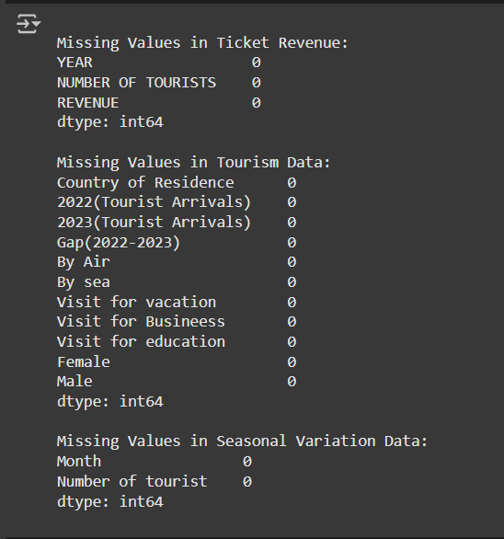
DATA PREPROCESSING
Checking for Missing Values
Key Steps: ✔ Identified missing values in each dataset ✔ Replaced inconsistent placeholders with NaN ✔ Assessed the impact of missing data on analysis
04.26.24

Slide 6
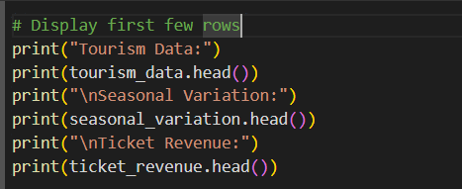
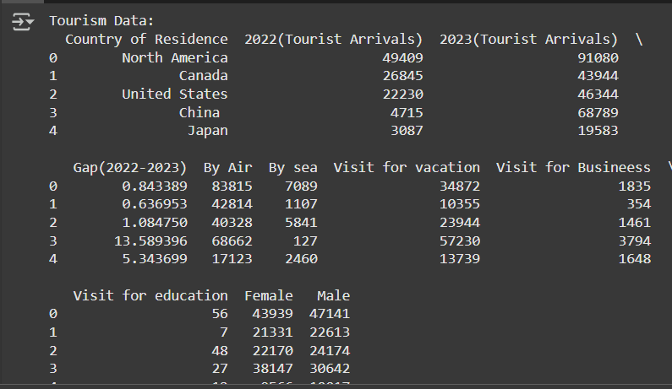
DATA PREPROCESSING
Data Preview
Key steps:
✔ Understand the structure and column names ✔ Identify missing values and inconsistencies ✔ Verify data types before cleaning
💡 This step ensures a clear understanding of the dataset before applying preprocessing techniques.
04.26.24

Slide 7


Python is a powerful tool for analyzing tourism data, helping to identify trends, patterns, and insights. Python enables data-driven decision-making, enhancing tourism strategies and forecasting future trends. 🚀
PYTHON FOR TOURISM DATA ANALYSIS

Slide 8
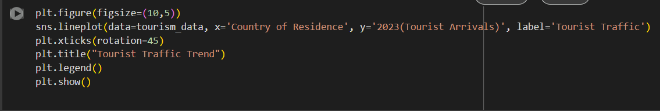
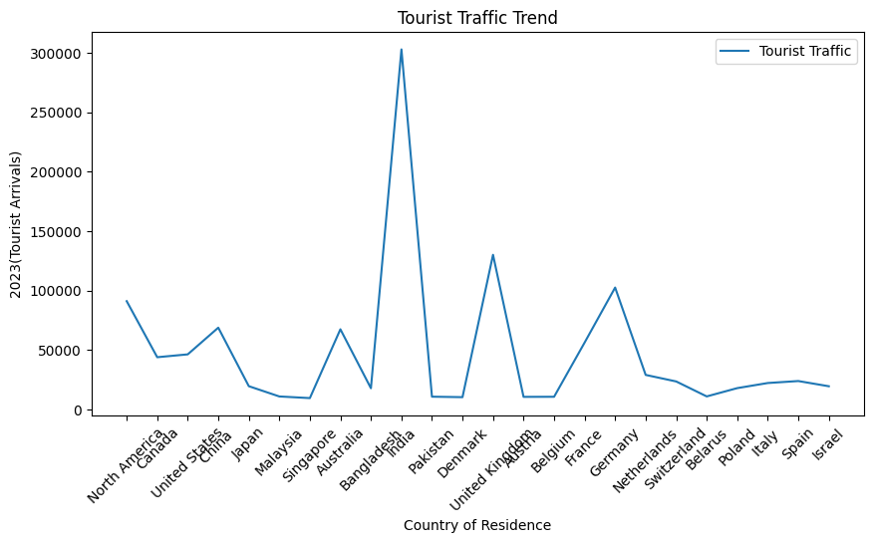
PYTHON FOR TOURISM DATA ANALYSIS
Tourist Traffic Trend Analysis (2023) 📊
🔍 Key Observations:
India recorded the highest tourist arrivals, exceeding 300,000, indicating its strong travel ties and popularity.
Significant tourist traffic was observed from the United Kingdom and Germany, highlighting strong outbound tourism from these countries.
Countries like Bangladesh, Pakistan, and North America also show noticeable peaks, reflecting steady tourism growth.
Japan, Malaysia, and Switzerland witnessed relatively lower tourist arrivals compared to other countries, possibly due to geographical distance or travel restrictions.
The fluctuating trend indicates varying travel preferences influenced by factors like economic conditions, visa policies, and seasonal tourism patterns.

Slide 9

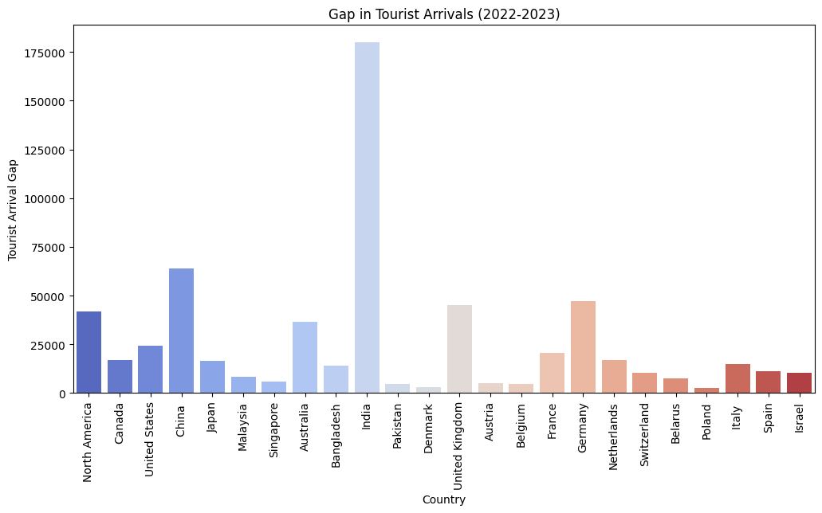
PYTHON FOR TOURISM DATA ANALYSIS
Gap in Tourist Arrivals (2022-2023) Analysis 📊
🔍 Key Observations:
India shows the largest increase in tourist arrivals, with a gap exceeding 175,000, indicating a significant post-pandemic recovery or enhanced travel interest.
Countries like China, Germany, and the United Kingdom also exhibit substantial growth in tourist numbers, reflecting improved international relations and travel demand.
Moderate increases can be seen in North America, Australia, and France, suggesting steady tourism recovery.
Lower gaps are observed in countries such as Denmark, Belgium, Belarus, and Poland, indicating minimal growth or stable tourist trends.
The color gradient (from cool to warm) visually emphasizes the variation, with cooler shades representing lower gaps and warmer shades indicating higher increases in tourist arrivals.

Slide 10
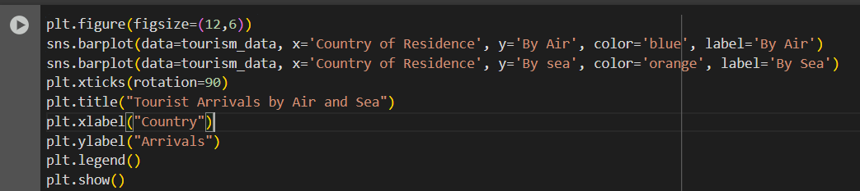
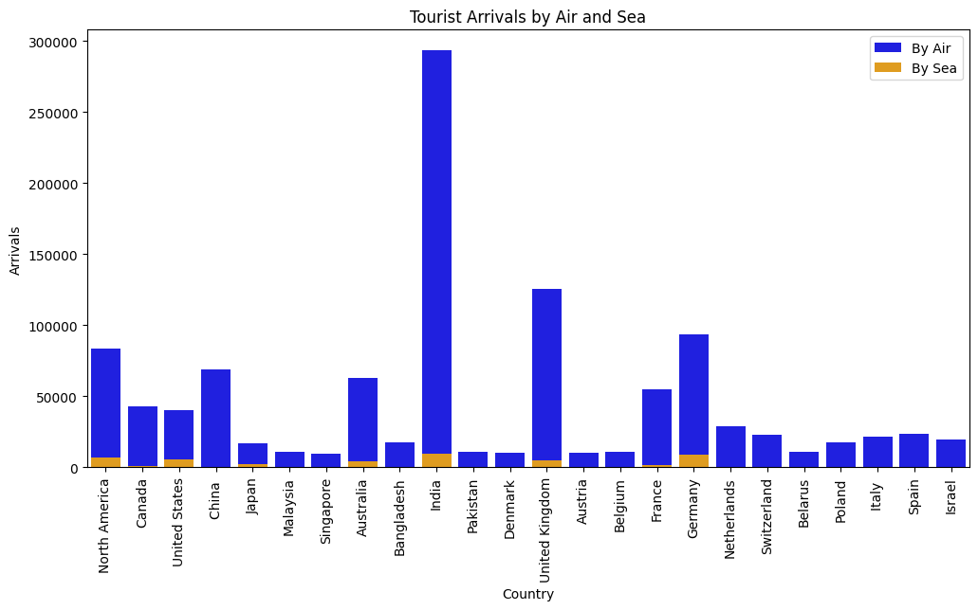
PYTHON FOR TOURISM DATA ANALYSIS
Tourist Arrivals by Air and Sea ✈️🚢
🌍 Key Insights:
Air travel dominates as the preferred mode of entry in all countries, with significantly higher numbers compared to sea arrivals.
India leads with the highest tourist arrivals by air, nearing 300,000 arrivals, followed by the United Kingdom, Germany, and North America.
Moderate air arrivals are observed from countries like China, Australia, and France, reflecting stable tourism connections.
Sea arrivals are minimal across all countries, indicating either limited sea travel options or a lower preference for this mode of transport.
The noticeable contrast in the bar heights highlights the reliance on air travel for international tourism, emphasizing the importance of air connectivity in global mobility.

Slide 11
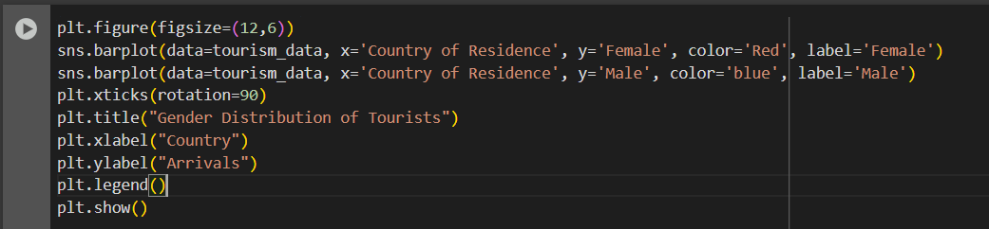
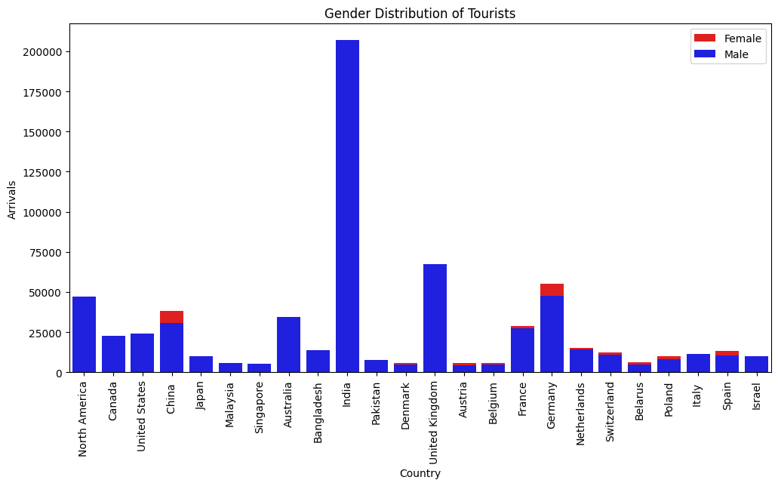
PYTHON FOR TOURISM DATA ANALYSIS
Gender Distribution of Tourists 👩‍🦰👨‍🦱
📊 Key Insights:
Male tourists dominate in arrivals across all countries, with significantly higher numbers compared to female tourists.
India shows the highest number of male tourists, exceeding 200,000 arrivals, followed by the United Kingdom, North America, and Germany.
Female tourist numbers are comparatively lower, but noticeable in countries like China, Germany, and France, where gender distribution is somewhat more balanced.
Countries like Bangladesh, Pakistan, and Malaysia show minimal female tourist representation, indicating potential cultural or social influences on travel behavior.
The stark contrast in bar heights reflects a gender gap in tourism patterns, highlighting areas where efforts to promote inclusive travel opportunities could be beneficial.

Slide 12
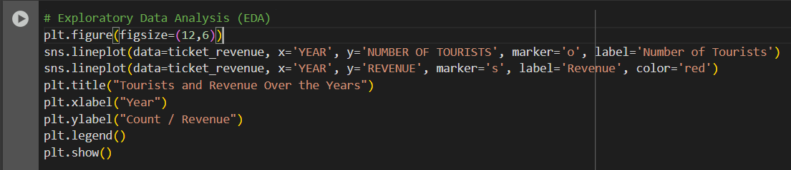
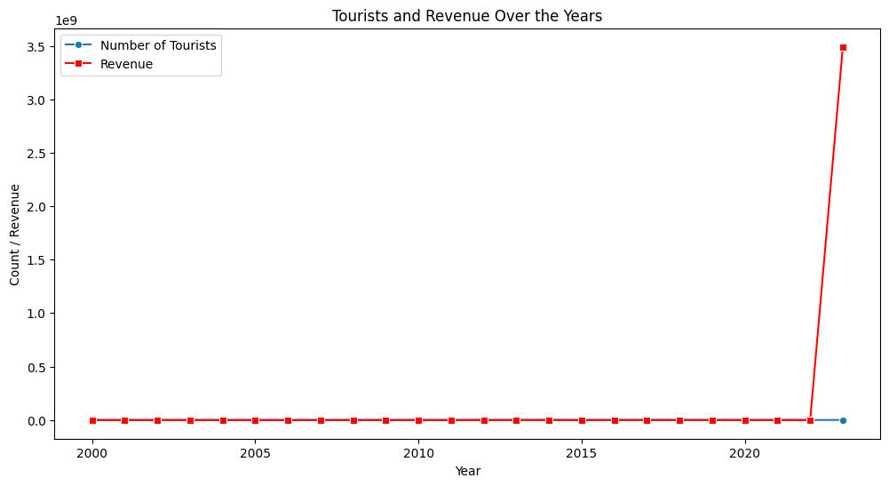
PYTHON FOR TOURISM DATA ANALYSIS
📈 Tourists and Revenue Over the Years 🌍💰
🔍 Key Observations:
Stable Growth (2000–2021): Both the number of tourists and revenue show a steady trend with minor fluctuations.
Sharp Spike in 2023: A dramatic surge in revenue is observed in 2023, reaching over 3.5 billion, which is disproportionately higher compared to previous years.
Tourist Numbers vs. Revenue: Despite the moderate growth in tourist arrivals, revenue skyrocketed in 2023, suggesting factors like:
Increased ticket prices
High-value tourism packages
Luxury tourism boom
Possible data anomaly that may require validation
Impact of Global Events: The COVID-19 pandemic around 2020 shows no drastic drop in tourist numbers, which could imply either resilience in tourism or incomplete data for that period.

Slide 13

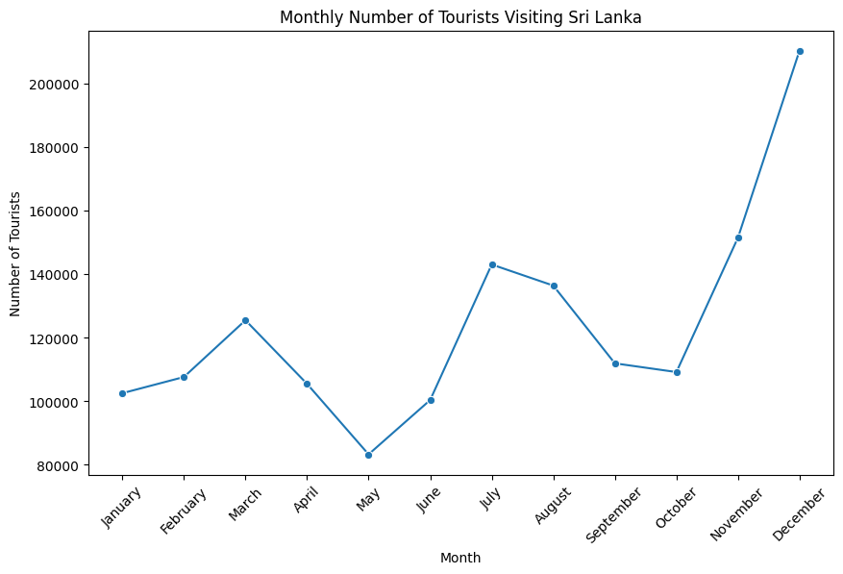
PYTHON FOR TOURISM DATA ANALYSIS
🌴 Monthly Number of Tourists Visiting Sri Lanka ✈️📊
🔍 Key Insights:
Peak Tourist Season:
December recorded the highest number of tourists with over 210,000 arrivals, indicating a strong year-end holiday effect due to festivals like Christmas and New Year celebrations.
November also shows a sharp rise, marking the start of the peak season.
Off-Peak Periods:
The lowest arrivals were observed in May (~83,000 tourists), likely due to the off-season and inter-monsoon weather conditions.
April to June shows a significant dip, possibly linked to the hot season and school exam periods in many countries.
Mid-Year Surge:
A noticeable increase in July and August, which could be influenced by summer vacations in Western countries and events like the Kandy Esala Perahera.
Steady Growth Trend:
The early months (January–March) show a gradual increase, reflecting post-holiday travel and favorable weather conditions for beach tourism.

Slide 14
This section presents a comprehensive dashboard that visually summarizes key insights from the data using interactive charts and graphs.. 🚀
DASHBOARD OVERVIEW

Slide 15
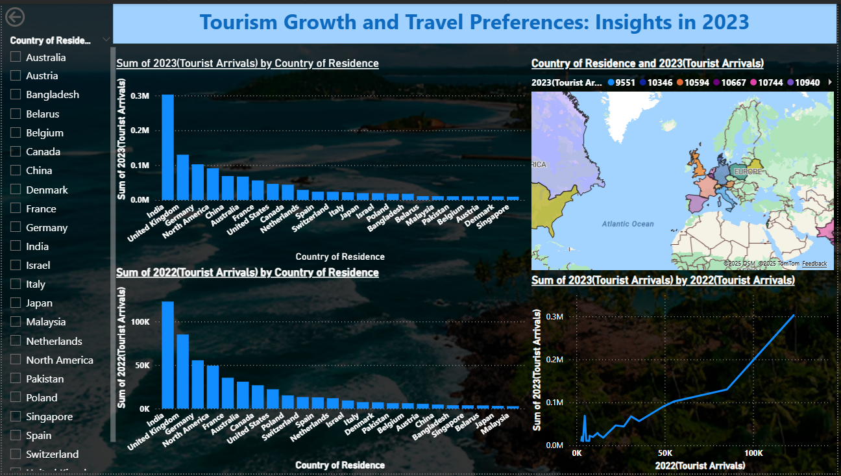
DASHBOARD OVERVIEW

Slide 16
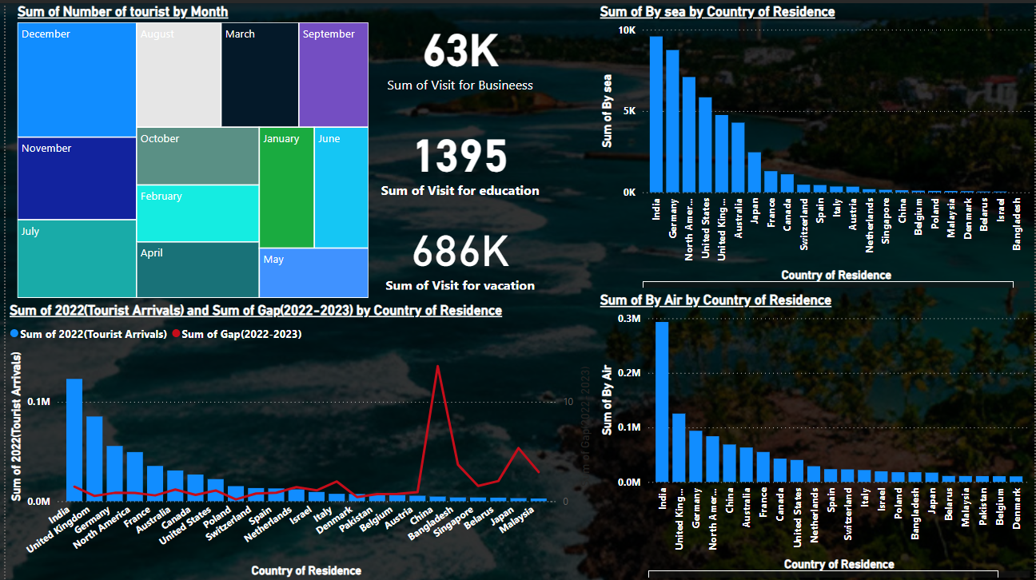
DASHBOARD OVERVIEW

Slide 17
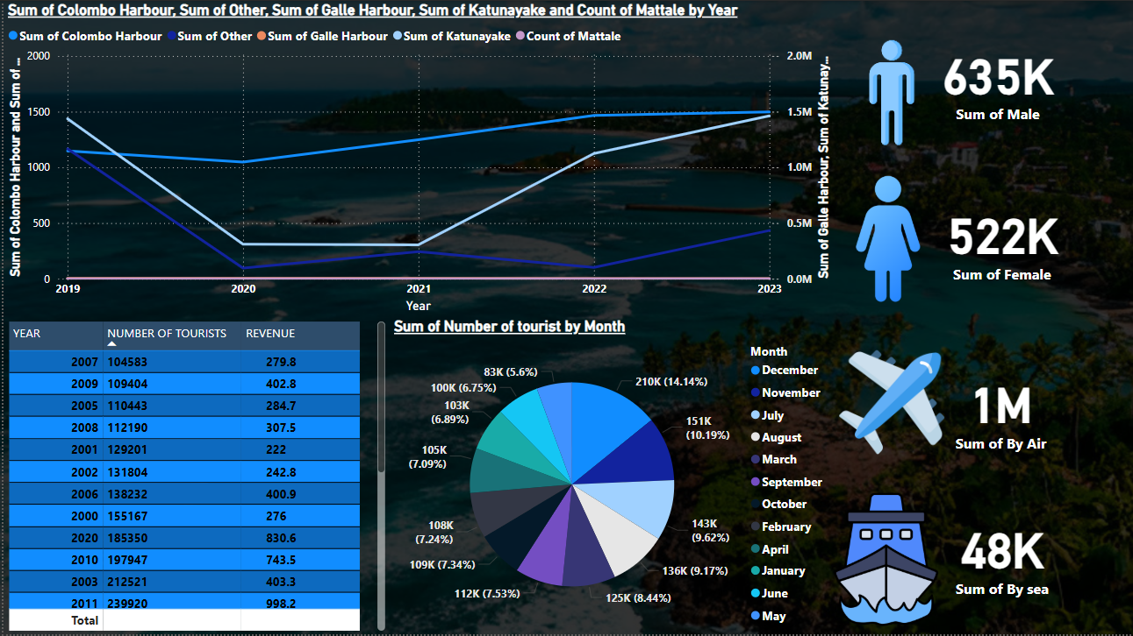
DASHBOARD OVERVIEW

Slide 18
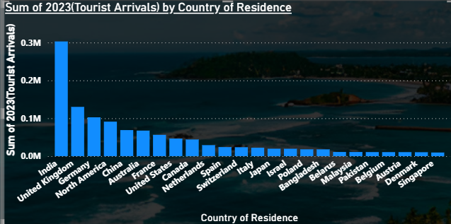
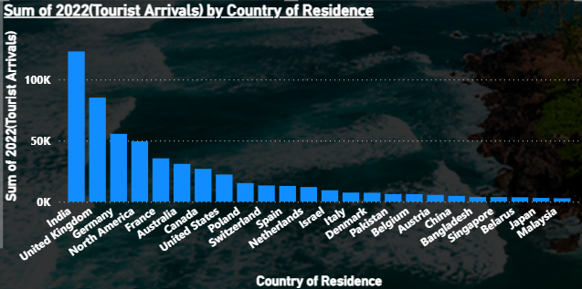
DASHBOARD OVERVIEW
1. Bar Chart - "Sum of 2023 (Tourist Arrivals) by Country of Residence"
Insights:
India had the highest number of tourist arrivals in 2023, followed by the UK and North America.
European countries such as France, Germany, and the Netherlands also contributed significantly.
Asian countries like China, Japan, and Malaysia had relatively lower tourist arrivals compared to Western countries.
Implication:
India remains the dominant source of tourists, indicating strong travel ties.
Western countries continue to be a key market for tourism, possibly due to economic factors and travel ease.
2. Bar Chart - "Sum of 2022 (Tourist Arrivals) by Country of Residence"
Insights:
Similar to 2023, India and the UK led in tourist arrivals in 2022.
Overall, the number of arrivals in 2022 appears lower than in 2023, showing tourism growth.
The ranking of countries remains largely the same, but some countries show notable increases in arrivals.
Implication:
Growth in tourist arrivals from 2022 to 2023 suggests a recovery in international travel.
Certain countries may have eased travel restrictions or improved connectivity, contributing to higher arrivals.

Slide 19
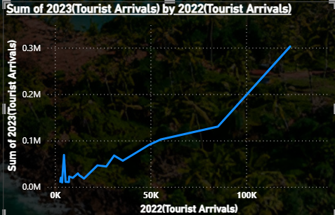
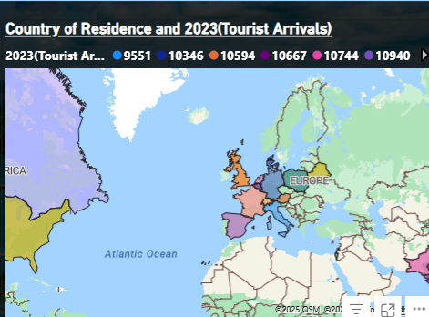
DASHBOARD OVERVIEW
3. Line Chart - "Sum of 2023 (Tourist Arrivals) by 2022 (Tourist Arrivals)"
Insights:
The upward trend suggests an overall increase in tourist arrivals from 2022 to 2023.
A strong correlation exists between the previous year’s arrivals and the current year’s growth.
Some countries show sharper increases than others, indicating possible changes in travel policies or preferences.
Implication:
The increase in arrivals suggests a positive tourism recovery trend.
Countries with steeper growth may indicate emerging tourism markets or new travel trends.
4. Map - "Country of Residence and 2023 (Tourist Arrivals)"
Insights:
The map visually represents tourist origins, highlighting higher tourist activity from regions.
Implication:
Visual clustering helps identify key tourism markets.
Targeted marketing strategies can be planned for regions with high tourism potential.

Slide 20
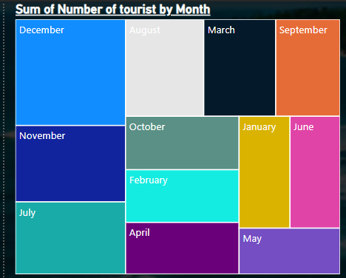
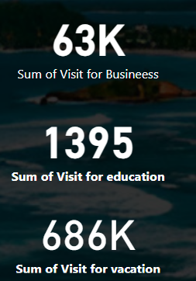
DASHBOARD OVERVIEW
5. Treemap - "Sum of Number of Tourists by Month"
Insights:
December, July, and November had the highest number of tourist arrivals.
Months like April, May, and June had moderate arrivals, while March and September had relatively lower numbers.
Implication:
Peak travel periods align with major holidays and vacation seasons.
Off-season months could be targeted for tourism promotions.
6. Key Figures
.63K tourists visited for business purposes.
1,395 tourists visited for educational purposes.
686K tourists visited for vacations.
Implication:
Vacation travelers dominate the tourism industry.
Business and educational travel are much lower but still contribute to overall tourism revenue.

Slide 21
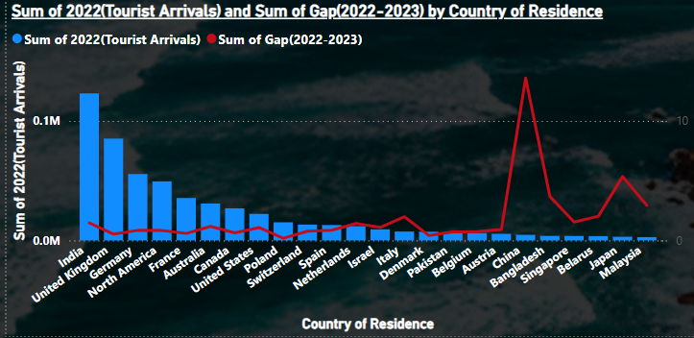
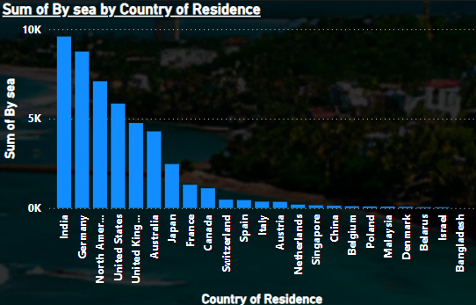
DASHBOARD OVERVIEW
7. Line & Bar Chart - "Sum of 2022 (Tourist Arrivals) and Sum of Gap (2022-2023) by Country of Residence"
Insights:
India, the UK, and Germany had the highest tourist arrivals in 2022.
The red line (Gap between 2022-2023) shows changes, indicating growth or decline in specific markets.
Some countries saw a sharp increase in arrivals, while others remained stable.
Implication:
Analyzing the gap helps identify growing markets and declining tourism sources.
Tourism policies can focus on sustaining growth in high-potential markets.
8. Bar Chart - "Sum of By Sea by Country of Residence"
Insights:
India had the highest number of sea arrivals, followed by Germany and North America.
Western European countries (UK, France, Switzerland) also had significant arrivals.
Asian countries like China, Singapore, and Malaysia had relatively fewer sea arrivals.
Implication:
India is a key market for sea travel, likely due to regional proximity.
Most long-distance travelers prefer air travel over sea routes.

Slide 22
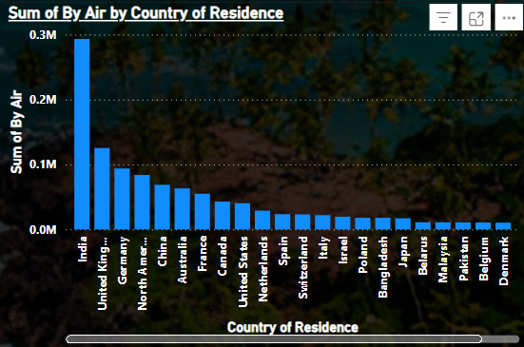
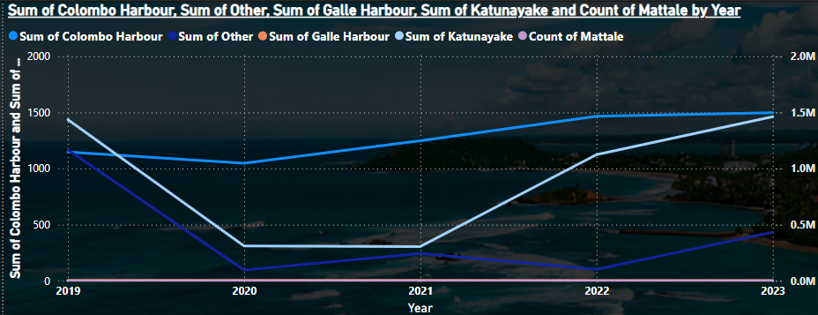
DASHBOARD OVERVIEW
9. Bar Chart - "Sum of By Air by Country of Residence"
Insights:
Air travel is the dominant mode of arrival, with India leading significantly.
The UK, Germany, and North America follow closely behind.
Smaller but notable contributions from European and Asian countries.
Implication:
Air connectivity plays a crucial role in attracting international tourists.
Strengthening air routes with key source countries can boost arrivals further.
10. Line Chart - "Tourist Arrivals by Port (2019-2023)"
Insights:
Tourist arrivals significantly dropped in 2020 due to the COVID-19 pandemic.
A gradual recovery began in 2021, with a significant rise in 2022 and 2023.
Katunayake Airport had the highest tourist arrivals, while Colombo Harbour and Galle Harbour had lower contributions.
Implication:
The tourism industry is recovering post-pandemic.
Air travel dominates over sea travel for international arrivals.

Slide 23
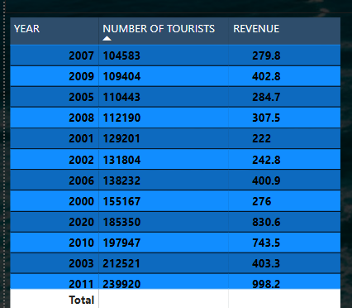
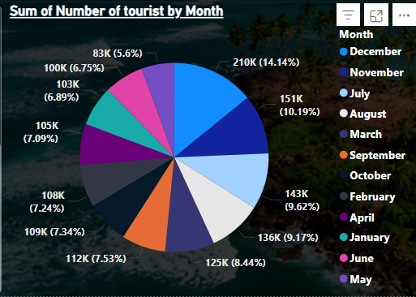
DASHBOARD OVERVIEW
11. Table (Bottom Left) - "Historical Tourism Data (2000-2020)"
Insights:
A steady rise in tourist arrivals from 2000 to 2011, peaking at 239,920 in 2011.
2020 saw a drastic decline (18,350 tourists) due to the global pandemic.
Revenue fluctuated across years but showed consistent growth before 2020.
Implication:
The sharp drop in 2020 emphasizes the impact of external factors like pandemics.
Understanding previous growth trends can help predict future recovery patterns.
12. Pie Chart (Bottom Right) - "Tourist Arrivals by Month"
Insights:
December (210K) had the highest tourist arrivals, followed by November (151K) and July (143K).
May, June, and September had the lowest arrivals (below 100K each).
Implication:
Peak seasons align with winter holidays in Western countries.
Off-peak months can be targeted for promotional campaigns to boost arrivals.

Slide 24
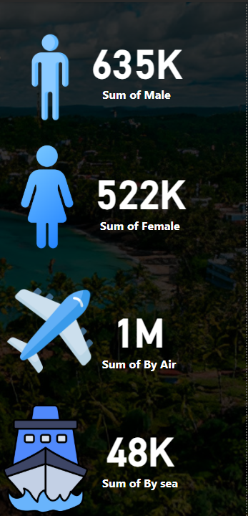
DASHBOARD OVERVIEW
13. Demographic Insights (Right Side Figures)
635K Male Tourists vs. 522K Female Tourists
Male tourists slightly outnumber female tourists.
1M Arrivals by Air vs. 48K Arrivals by Sea
Air travel is the primary mode of entry, while sea travel remains minimal.
Implication:
The focus should remain on improving air travel facilities.
A deeper analysis could reveal why male travelers dominate and how to attract more female tourists.

Slide 25

KEY FINDINGS & INSIGHTS
Tourism Growth & Recovery📈
Sri Lanka experienced a significant increase in tourist arrivals from 2022 to 2023.
India led in tourist arrivals, followed by the UK, Germany, and North America.
The sharp rise in revenue in 2023 (over $3.5 billion) suggests higher spending per tourist or increased ticket prices.
2. Travel Patterns & Preferences✈️
Air travel is the dominant mode of entry, with minimal arrivals by sea.
December is the peak month for tourism, while May sees the lowest arrivals.
Male tourists outnumber female tourists across all nationalities.
3. Seasonal & Economic Influences🌍💰
Tourist arrivals dip between April and June, likely due to hot weather and school exams.
Economic conditions, visa policies, and global events play a role in fluctuating tourism numbers.
4. Demographic & Regional 🏖️
InsightsWestern countries (UK, Germany, France) and South Asian nations (India, Bangladesh, Pakistan) contribute significantly to arrivals.
Luxury tourism and high-value packages could be contributing to the revenue surge.
Business and educational travel remain a small but notable portion of total arrivals.
04.26.24

Slide 26
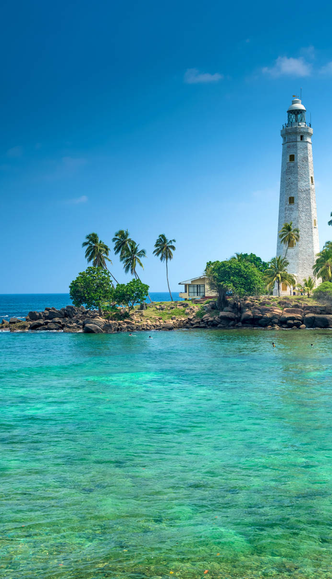
FUTURE PREDICTIONS & RECOMMENDATIONS
🌍 Future Predictions
Continued Growth in Tourism 📈
Sri Lanka will liely see a steady increase in tourist arrivals, driven by improved global travel conditions and strategic marketing.
India, the UK, aknd Germany will remain top contributors, with potential growth from China and the Middle East.
Luxury & High-Value Tourism Expansion 🏝️
The rise in high-end travel packages and boutique tourism will boost revenue.
Eco-tourism and wellness tourism (spas, retreats) will attract premium travelers.
Technology-Driven Tourism 📊
AI-powered recommendations, digital booking platforms, and interactive dashboards will enhance travel experiences.
Augmented reality (AR) experiences in heritage sites may increase engagement.
Seasonal & Economic Impact 🌦️
December and mid-year peaks will continue, while off-season months (May-June) may need incentives to attract tourists.
Economic factors like currency fluctuations and global recessions may influence spending habits.
04.26.24

Slide 27
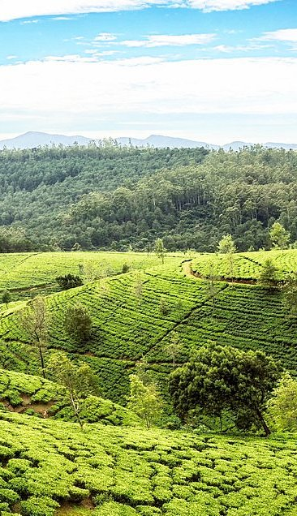
FUTURE PREDICTIONS & RECOMMENDATIONS
✅ Recommendations
Enhancing Air Connectivity ✈️
Strengthen direct flight routes from emerging markets like China, the Middle East, and Southeast Asia.
Improve partnerships with budget airlines to make Sri Lanka a more accessible destination.
Diversifying Tourism Offerings 🎭
Develop adventure tourism (hiking, surfing, wildlife safaris) to attract younger travelers.
Promote rural tourism and cultural heritage experiences for a unique visitor experience.
Targeted Marketing Strategies 🎯
Digital marketing campaigns tailored for high-potential markets (social media, influencers).
Offer discounts or package deals for off-peak travel months to balance visitor flow.
Sustainability & Eco-Tourism Initiatives 🌱
Encourage green tourism initiatives, eco-resorts, and sustainable travel practices.
Implement stricter conservation policies for national parks and heritage sites.
04.26.24

Slide 28

CONCLUSION
Sri Lanka’s tourism sector is on a strong recovery path, showing significant growth in 2023. Key markets such as India, the UK, and Germany continue to drive arrivals, while high-value tourism is boosting revenue. However, challenges like seasonal fluctuations and economic conditions require strategic planning.
By enhancing air connectivity, diversifying tourism experiences, and adopting digital innovations, Sri Lanka can attract a broader audience. Sustainable tourism initiatives will also ensure long-term industry resilience. With data-driven strategies and targeted marketing, Sri Lanka has the potential to become a top global travel destination. 🌍✨
04.26.24

Slide 29

Q&A

Slide 30
SRI LANKA
02.2.25
THANK YOU!

